Slide 1
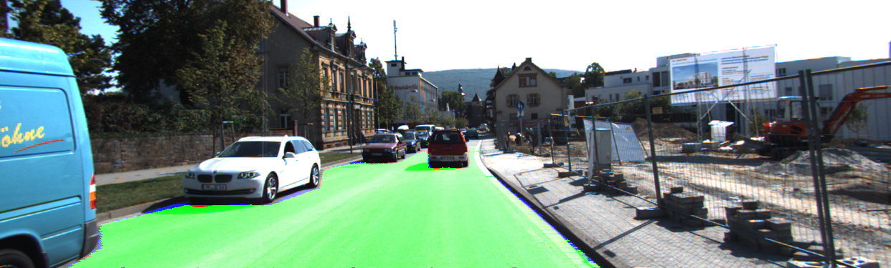
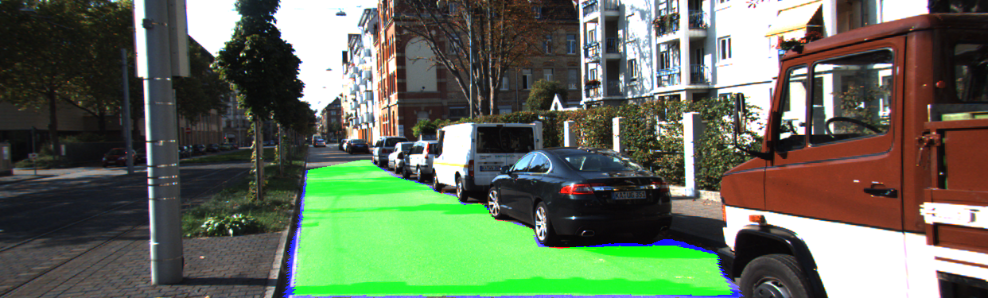
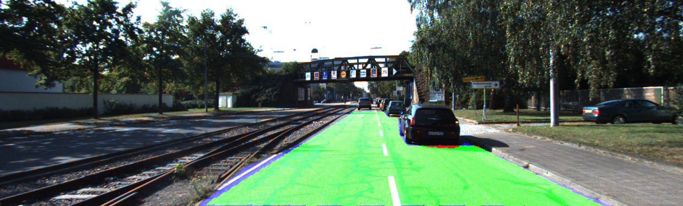
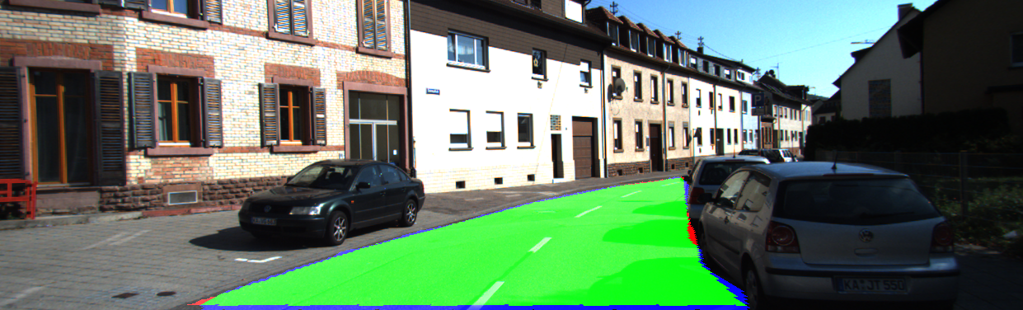

Slide 2
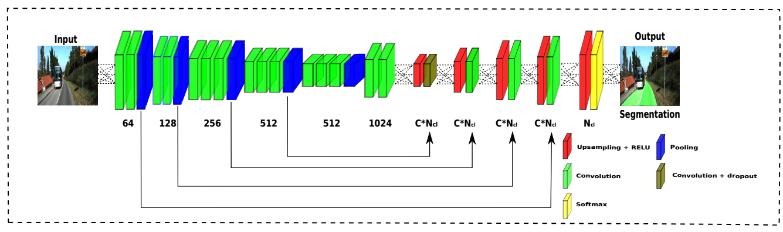
Related work
Efficient Deep Models for Monocular Road Segmentation. IROS 2016

Slide 3
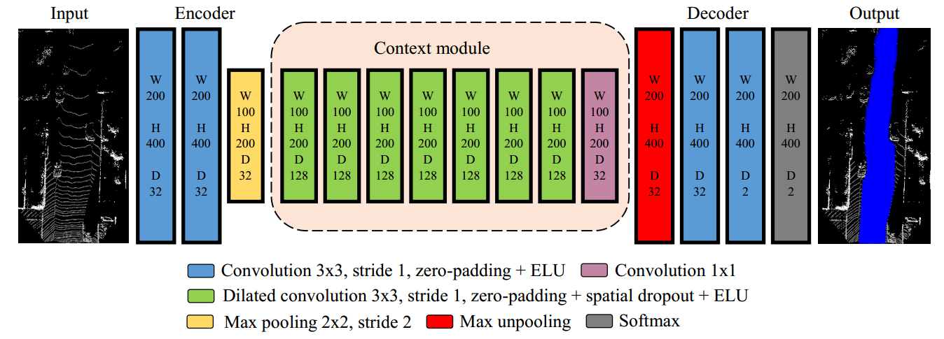
Related work
[-10, 10]
[6, 46]
cell=0.1 x 0.1
number of points;
reflectivity;
elevation.
Fast LIDAR-based Road Detection Using Fully Convolutional Neural Networks.
IEEE Intelligent Vehicles Symposium 2017.

Slide 4
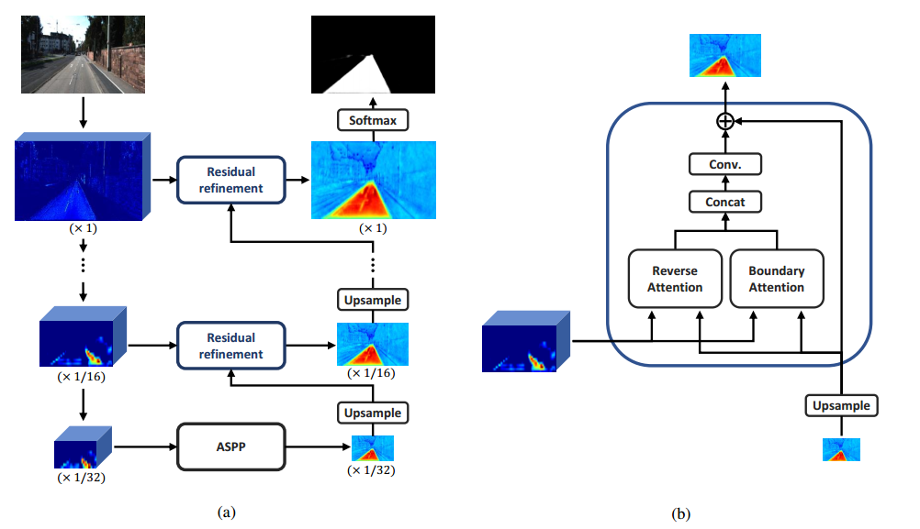
Related work
Reverse and Boundary Attention Network for Road Segmentation. ICCVW 2019.

Slide 5
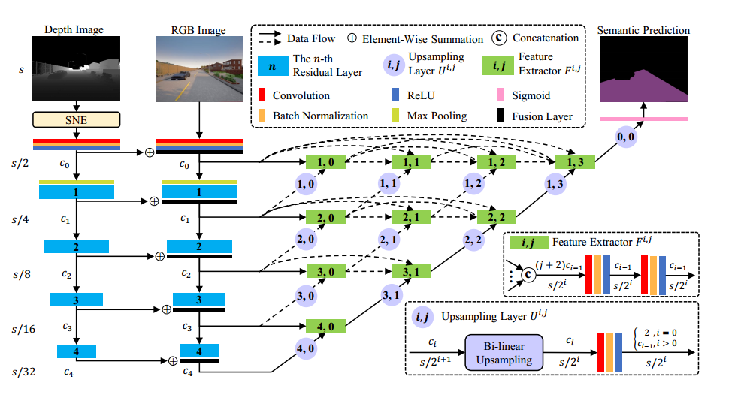
Related work
SNE-RoadSeg: Incorporating Surface Normal Information into Semantic Segmentation for Accurate Freespace Detection. ECCV 2020.

Slide 6
Motivation
The core issue: How to fuse image and point cloud information ?
LiDAR data and its extracted features do not share the same space with the visual data and visual features
Data space adaptation; feature space adaptation

Slide 7
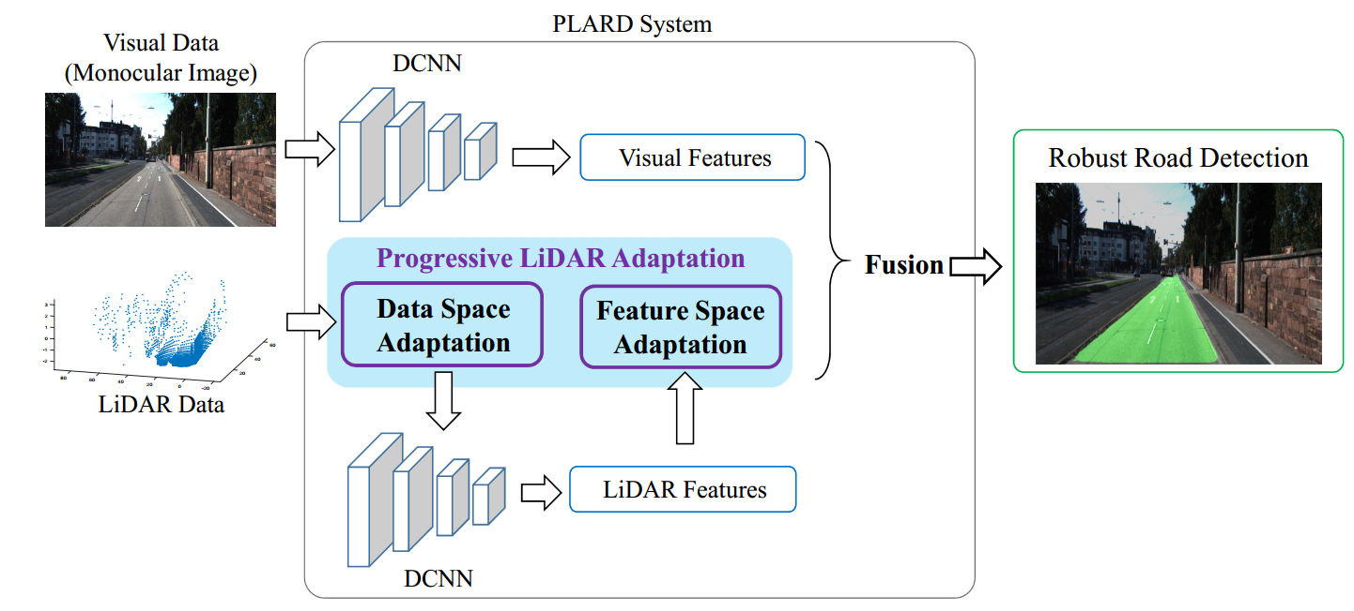
Overview

Slide 8
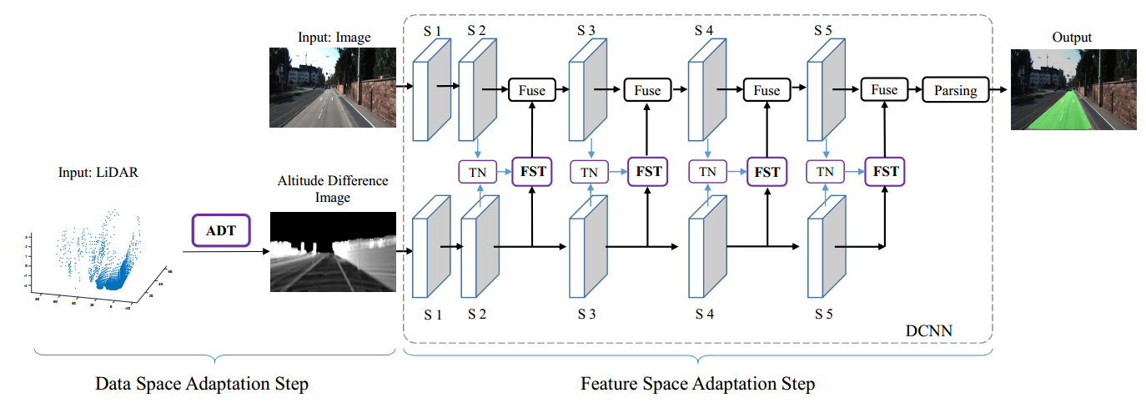
Pipeline

Slide 9
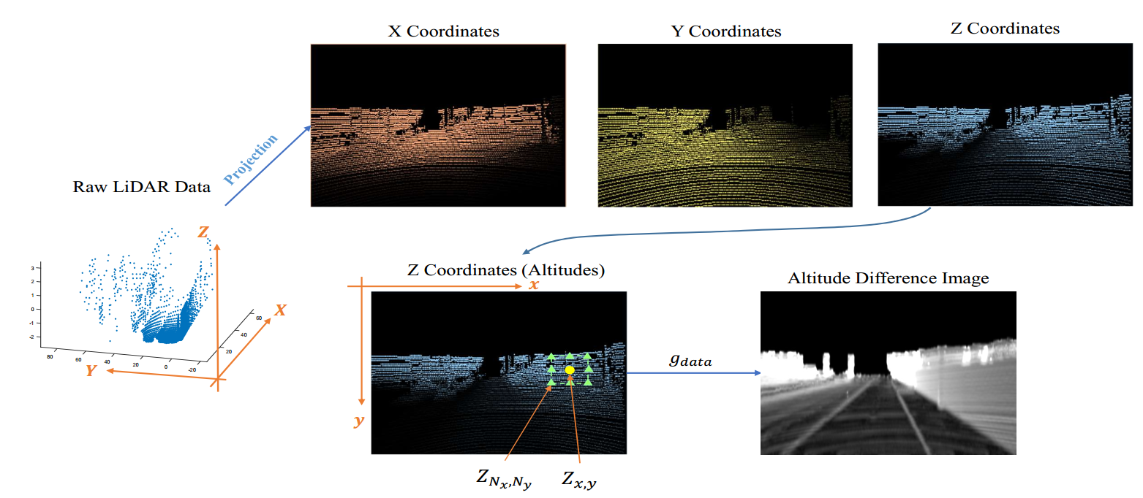
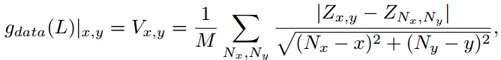
Data adaptation

Slide 10
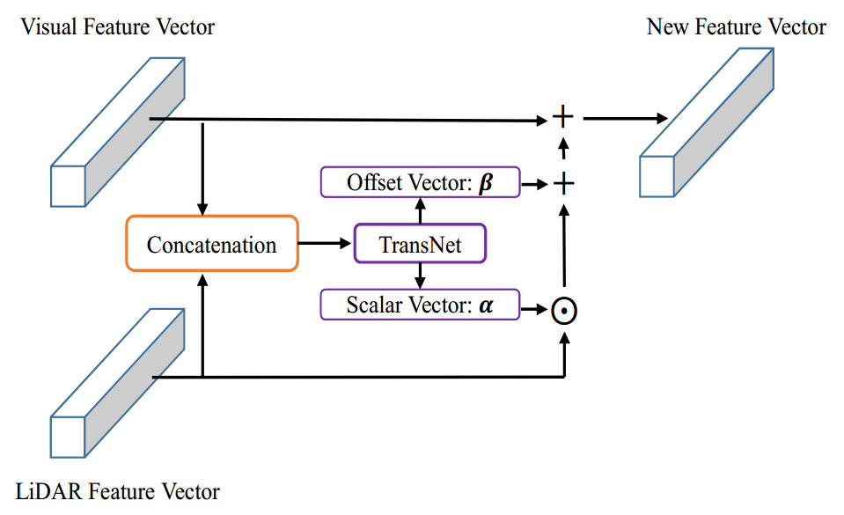

Slide 11
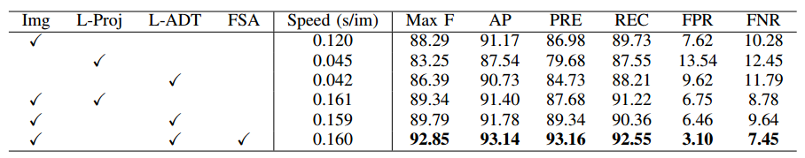
Ablation

Slide 12
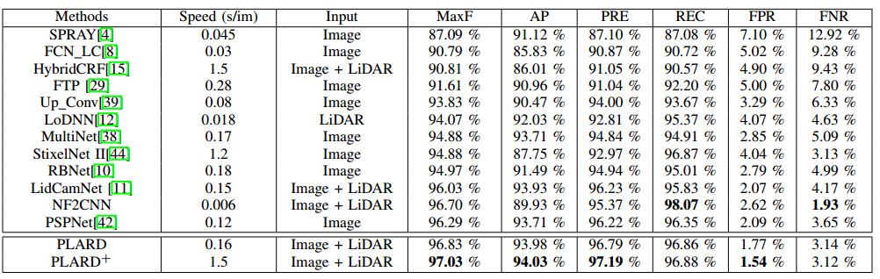
Performance

Slide 13
Thanks

